Slide 1

Flow Characteristics in Single Expansion Ramp Nozzle at Overexpanded Condition
By
Md Asaduzzaman (S201710100)
Mehedi Hasan (S201710060)
Under the supervision of
Dr. A. B. M. Toufique Hasan
Professor
Department of Mechanical Engineering
Bangladesh University of Engineering and Technology

Slide 2
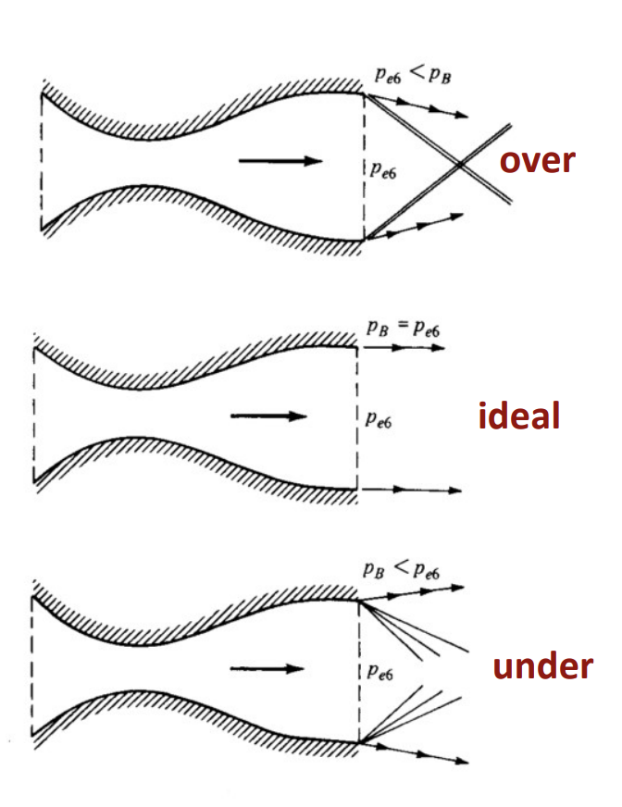
Introduction
Single Expansion Ramp Nozzle
Why Single Expansion Ramp Nozzle?
Over Expanded Condition
Physically straight expansion nozzle where only one side of the gas pressure is transferred.
Due to its greater adaptability and lighter structure
If the nozzle exit pressure is less than the back pressure

Slide 3
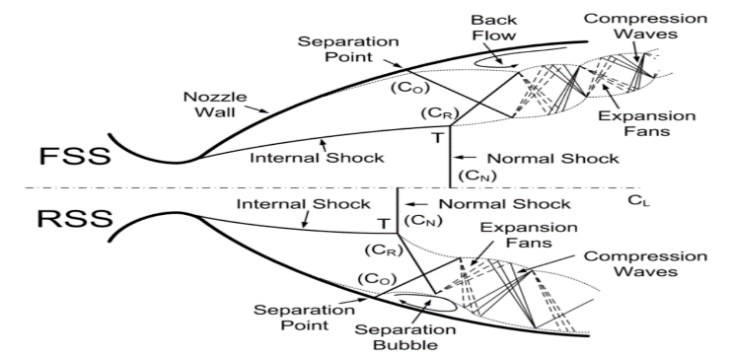
Introduction
Flow Separation
FSS
RSS
FSS: Free Shock Separation
RSS: Restricted Shock Separation

Slide 4
Literature Review
Year | Author | Description
1985 | Delerly | SWBLI can lead to damaging effects, including the separation of the boundary layer, rapid growth of a dissipative region, intensified turbulent fluctuations, and frequent buffeting
2005 | Bourgoing and Reijasse | investigated the influence of the approaching boundary layer state and wall roughness on shock patterns, finding that asymmetry was reduced with wall roughness modification, resulting in altered shock patterns and shifted reattachment points downstream.
2014 | Yu et al. | the loss of performance due to flow separation in an over-expanded single expansion ramp nozzle (SERN) during the startup and shutdown process
2023 | Yu et al. | simulated the transitions of separation patterns during the acceleration and deceleration processes of a short flap SERN

Slide 5
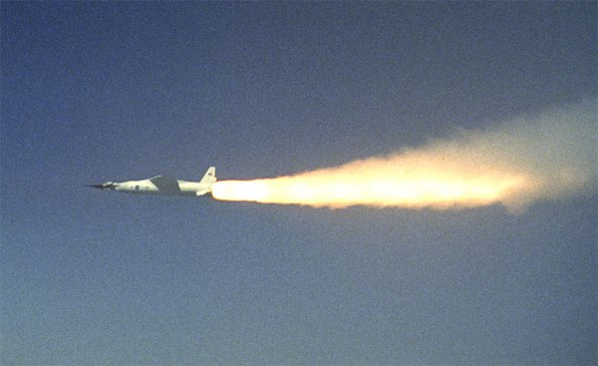
Motivation
High cost of experimental work
Interest on Internal Aerodynamics and Nozzle flow
Increasing use of Single Expansion Ramp Nozzle
To explore more about flow separation in nozzle
X-43 A

Slide 6
Aim of the thesis
To develop a computational model to predict the flow pattern in a subscale SERN
To investigate the flow separation pattern in SERN for different flap length
To investigate the flow separation pattern in SERN for different expansion ramp angle
To calculate the thrust for different conditions
To investigate the flow separation pattern in SERN for different NPR ranges

Slide 7
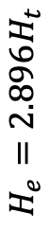
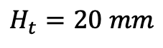
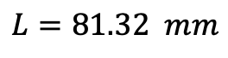
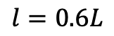
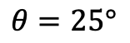
Physical Modeling: Geometry
Short Flap Model
Long Flap Model
Ramp
$$θ=25°$$
$$H_{e}=2.896H_{t}$$
Exit
Inlet
Throat
$$H_{t}=20 mm$$
Flap
$$l=0.6L$$
$$L=81.32 mm$$

Slide 8
Physical Modeling: Flow Conditions
Pressure-inlet | Total Pressure=93243.668 Pa, temperature= 300K
Ambient-inlet | Ma=0, pressure=31073.02 Pa, temperature=300K
Pressure Outlet | Pressure=31073.02 Pa, temperature=300K
Wall (Others) | Adiabatic

Slide 9
Physical Modeling: Variable Parameters
Case No | Flap Length | Expansion Ramp Angle | NPR
1 | 0.6L | 25 Degree | 2.4
2 |  |  | 2.7
3 |  |  | 3.0
4 |  |  | 3.4
5 |  |  | 3.6
6 |  |  | 3.9
7 |  |  | 4.2
8 |  |  | 4.5
9 |  |  | 4.8
10 |  | 27 Degree | 2.4
11 |  |  | 2.7
12 |  |  | 3.0
13 |  |  | 3.4
14 |  |  | 3.6
15 |  |  | 3.9
16 |  |  | 4.2
17 |  |  | 4.5
18 |  |  | 4.8

Slide 10
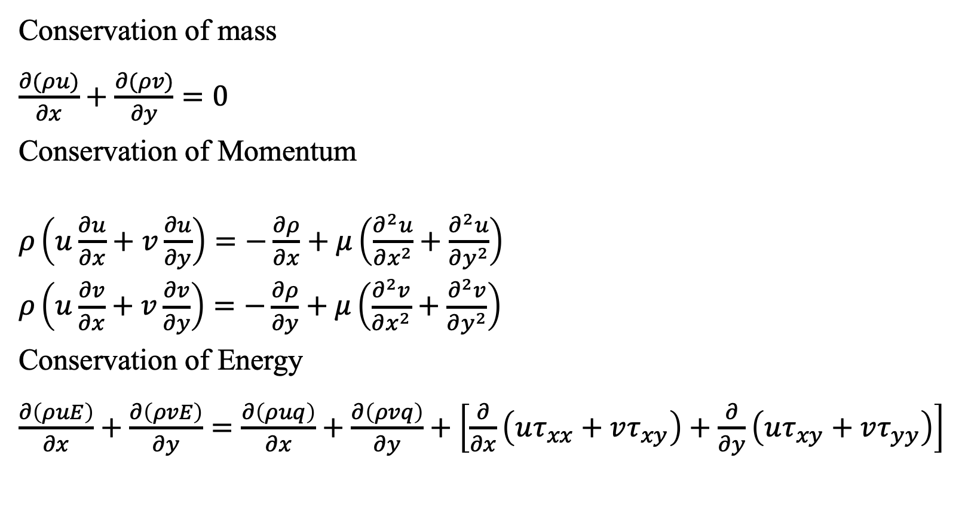
Mathematical Modeling: Governing Equations
Conservation of mass
$\frac{∂(ρu)}{∂x}+\frac{∂(ρv)}{∂y}=0$
Conservation of Momentum
$\begin{aligned}&ρ\left(u\frac{∂u}{∂x}+v\frac{∂u}{∂y}\right)=−\frac{∂ρ}{∂x}+μ\left(\frac{∂^{2}u}{∂x^{2}}+\frac{∂^{2}u}{∂y^{2}}\right) \\ &ρ\left(u\frac{∂v}{∂x}+v\frac{∂v}{∂y}\right)=−\frac{∂ρ}{∂y}+μ\left(\frac{∂^{2}v}{∂x^{2}}+\frac{∂^{2}v}{∂y^{2}}\right)\end{aligned}$
Conservation of Energy
$\frac{∂\left(ρuE\right)}{∂x}+\frac{∂\left(ρvE\right)}{∂y}=\frac{∂\left(ρuq\right)}{∂x}+\frac{∂\left(ρvq\right)}{∂y}+\left[\frac{∂}{∂x}\left(uτ_{xx}+vτ_{xy}\right)+\frac{∂}{∂y}\left(uτ_{xy}+vτ_{yy}\right)\right]$

Slide 11

Mathematical Modeling: Numerical Scheme
Computational Platform: ANSYS FLUENT v14.5
Discretization: Finite Volume Method
Formulation: Density-based Implicit
Accuracy: Second-Order Upwind
Time: Steady State
Node: 112536
Viscous Model: RNG k-epsilon

Slide 12
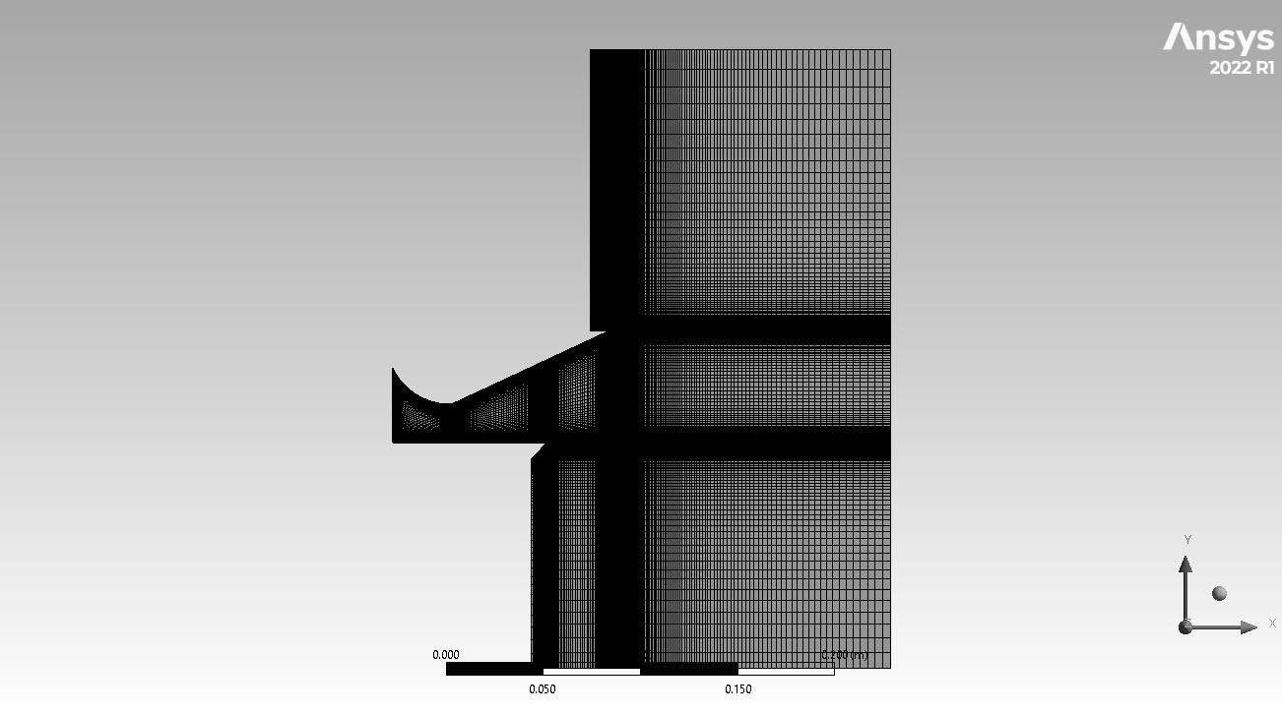
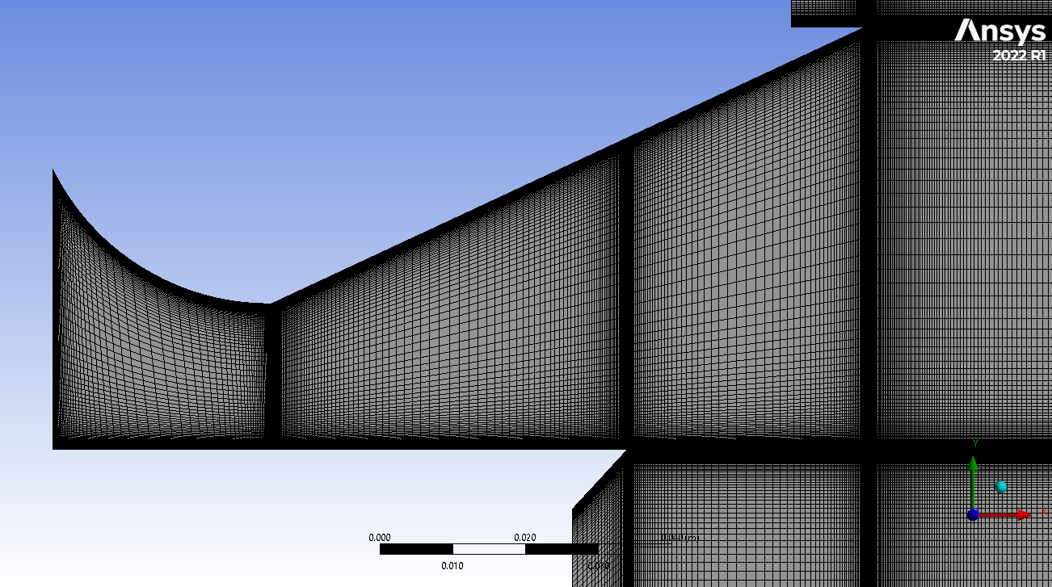
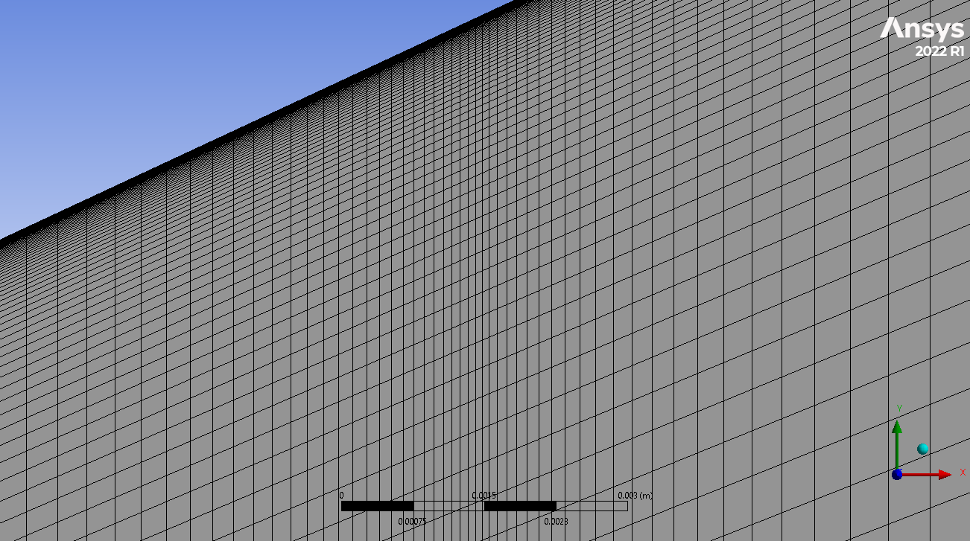
Computational Grid

Slide 13
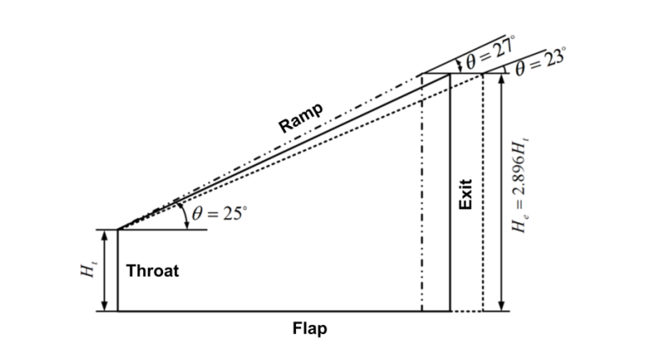
Validation: Geometry & Flow Conditions
An Experiment Conducted by Yu et al. at Nanjing University of Aerospace and Aeronautics (2014)
Pressure-inlet | Total Pressure=93243.668 Pa, temperature= 300K
Ambient-inlet | Ma=0, pressure=31073.02 Pa, temperature=300K
Pressure Outlet | Pressure=31073.02 Pa, temperature=300K
Wall (Others) | Adiabatic

Slide 14
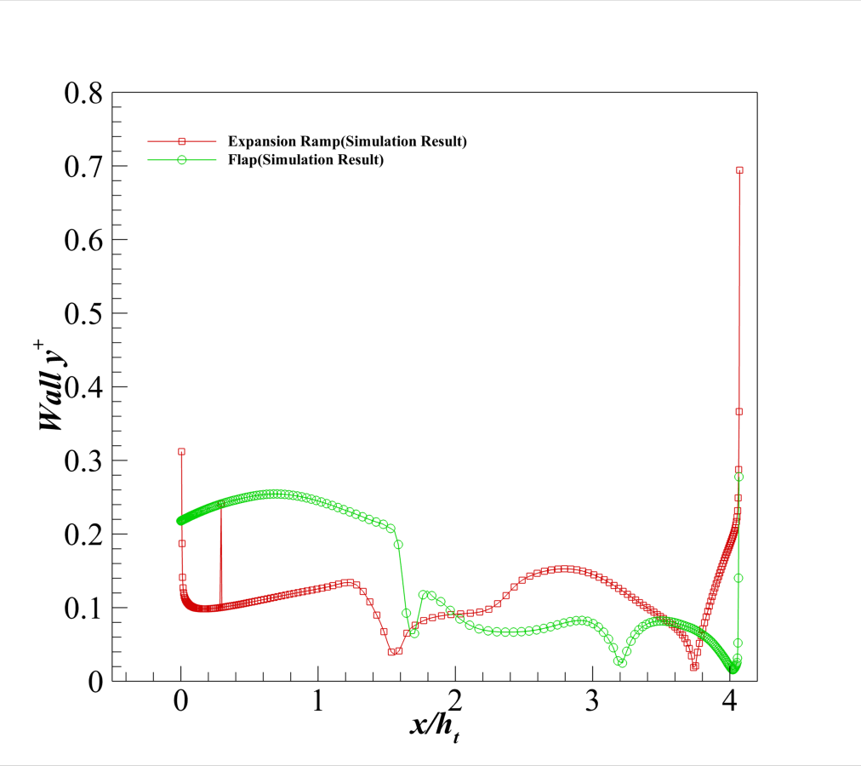
Validation: Wall Y⁺

Slide 15
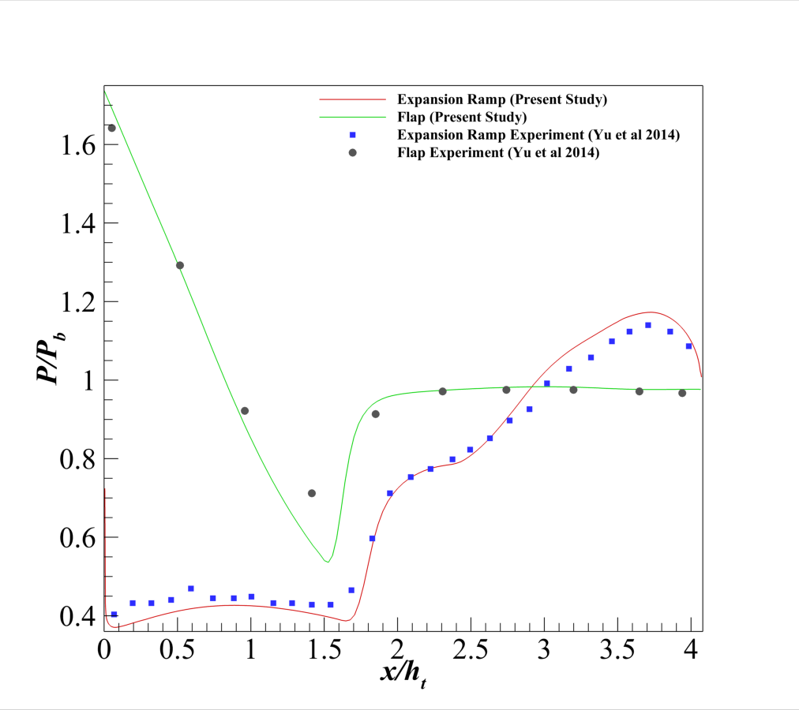
Validation: Effects on Wall Pressure Distribution

Slide 16
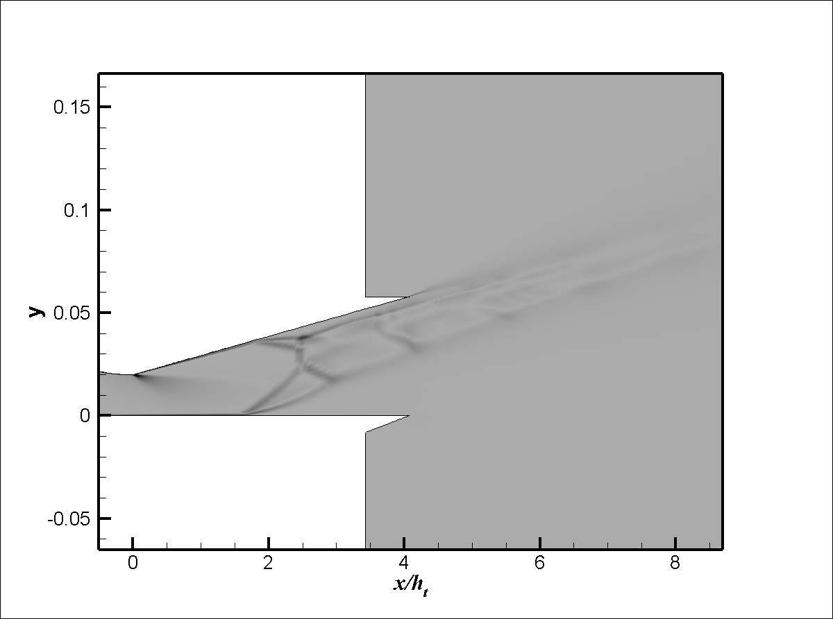
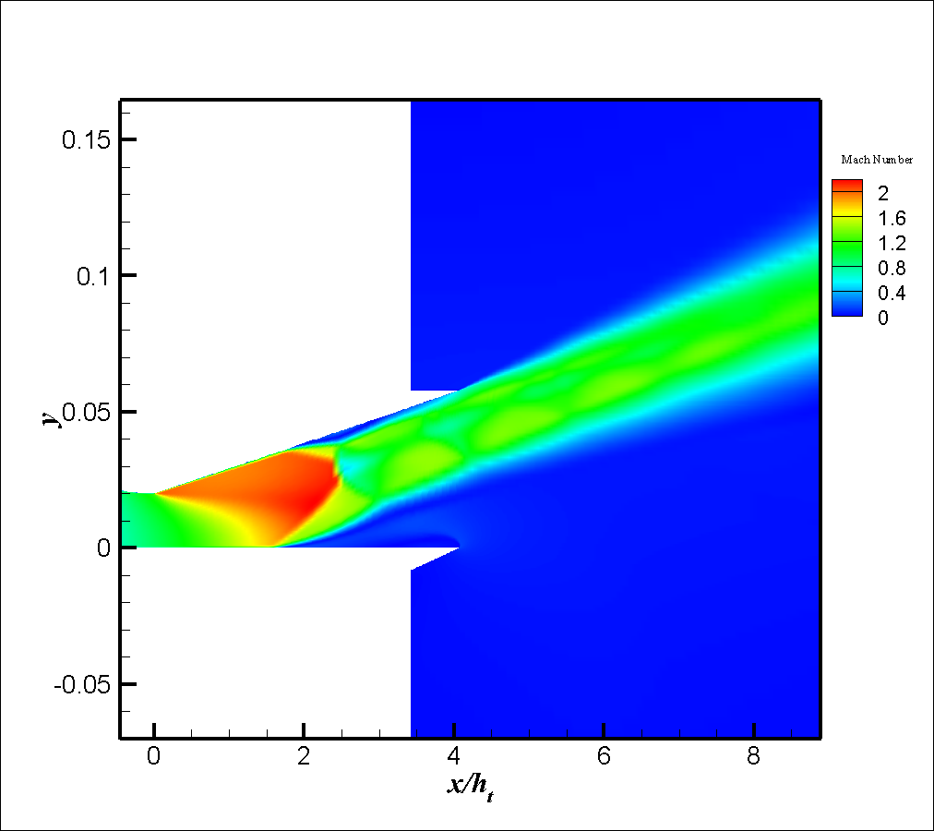
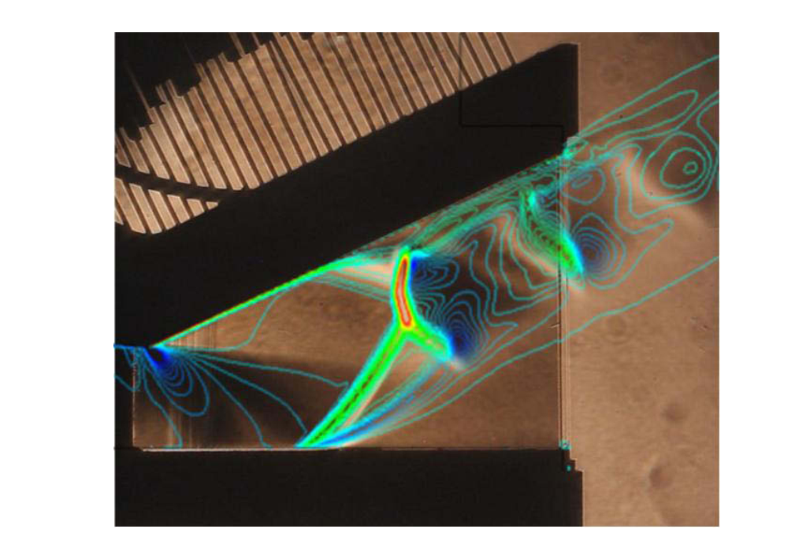
Validation: Flood Contour

Slide 17
Validation: Comment
The pressure distribution is similar with the experimental work.
The mach contour and density gradient is also similar
So further study continues according to the objectives.

Slide 18
Results: Mach Contour Analysis
(a) NPR 2.4
(b) NPR 2.7
(c) NPR 3.0
(d) NPR 3.9
(e) NPR 4.2
(f) NPR 4.8
Fig.01 : Mach Contour for Expansion ramp angle 25 degree at different NPR

Slide 19
Results: Mach Contour Analysis
(a) NPR 2.4
(b) NPR 2.7
(c) NPR 3.0
(d) NPR 3.9
(e) NPR 4.2
(f) NPR 4.8
Fig.02 : Mach Contour for Expansion ramp angle 27 degree at different NPR

Slide 20
Results: Mach Contour Analysis
25 degree
(a)
(b)
(c)
27 degree
(a)
(b)
(c)
Fig.03: Comparison of Mach Contour for two different Expansion ramp angles at NPR (a) 2.4 (b) 3.0 (c) 3.9

Slide 21
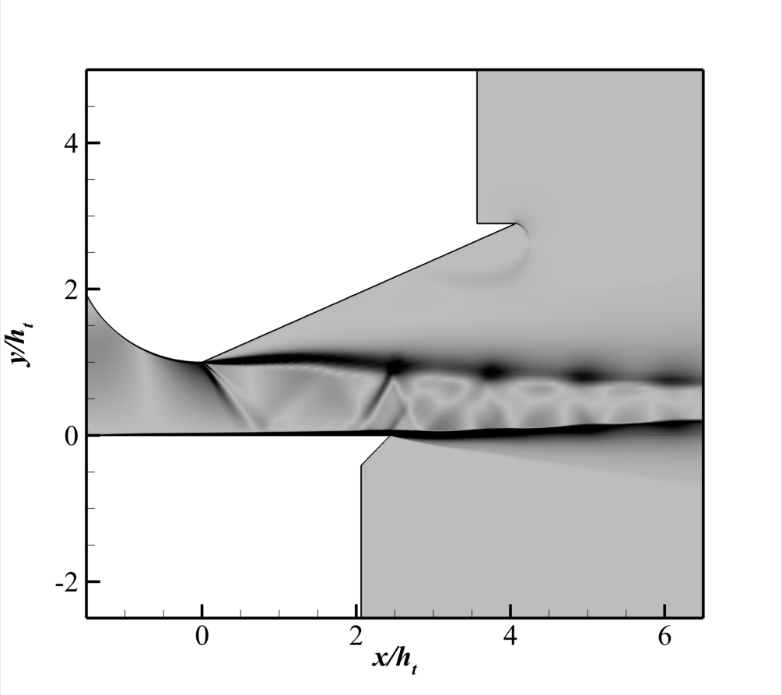
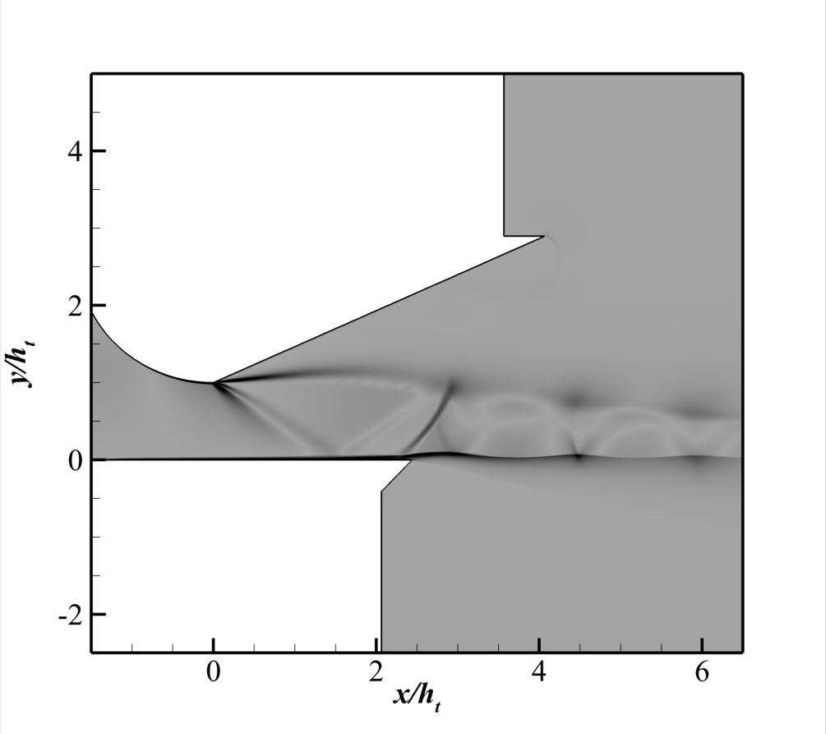
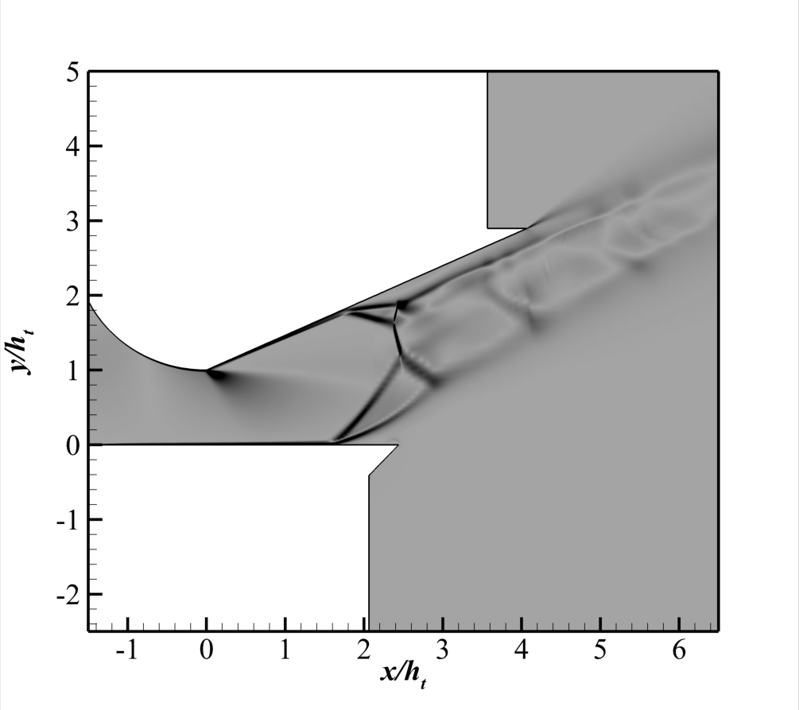
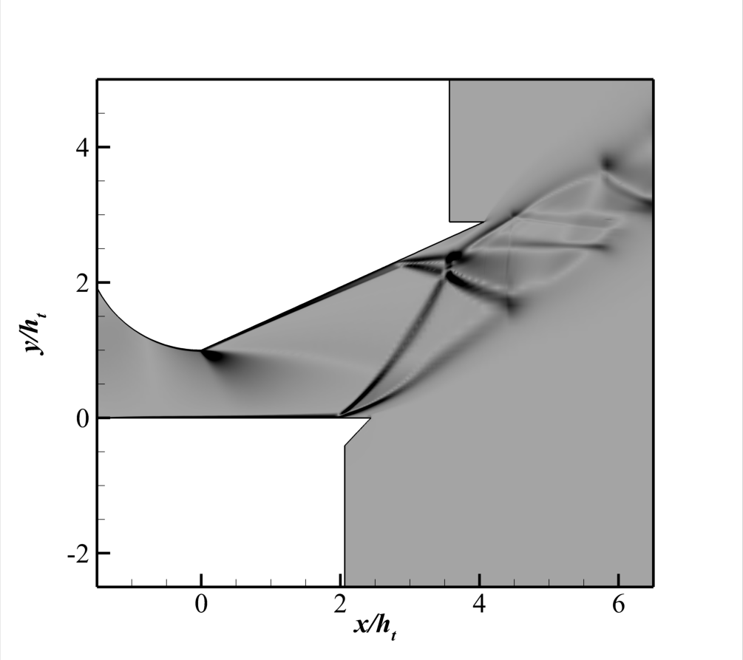

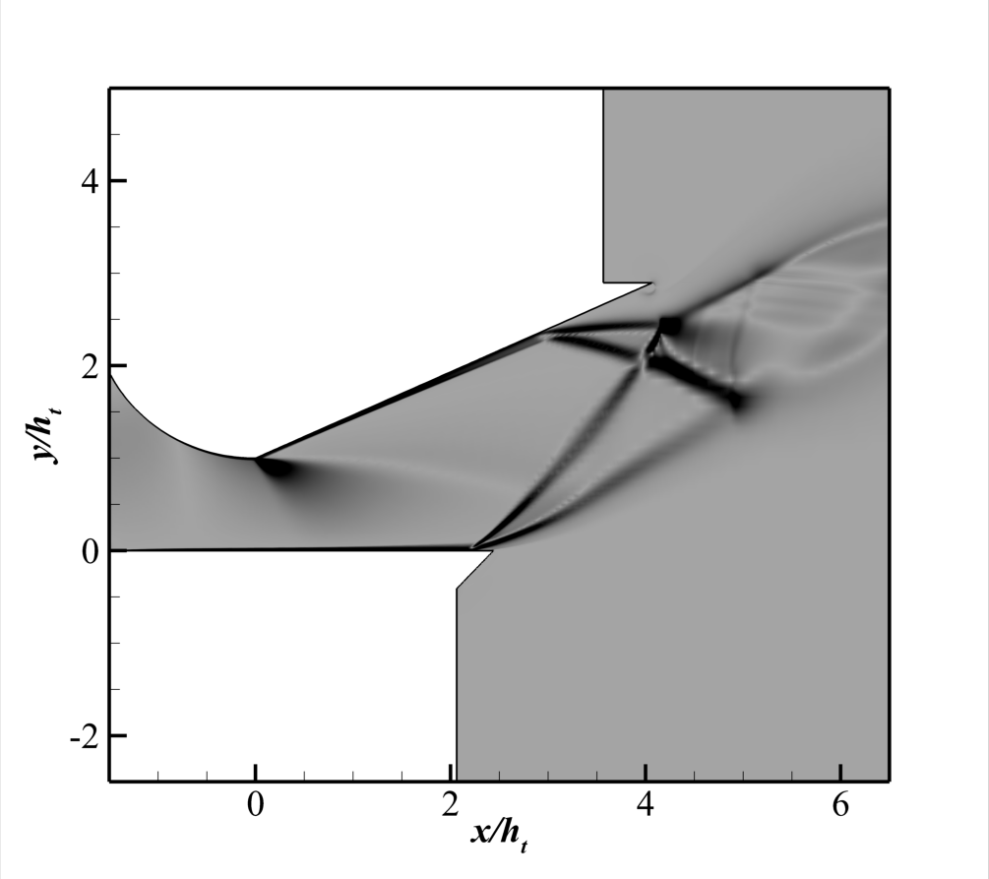
Results: Shock Interaction Analysis
(a) NPR 2.4
(b) NPR 2.7
(c) NPR 3.0
(d) NPR 3.9
(e) NPR 4.2
(f) NPR 4.8
Fig.04: Density gradient Contour for Expansion ramp angle 25 degree at different NPR

Slide 22
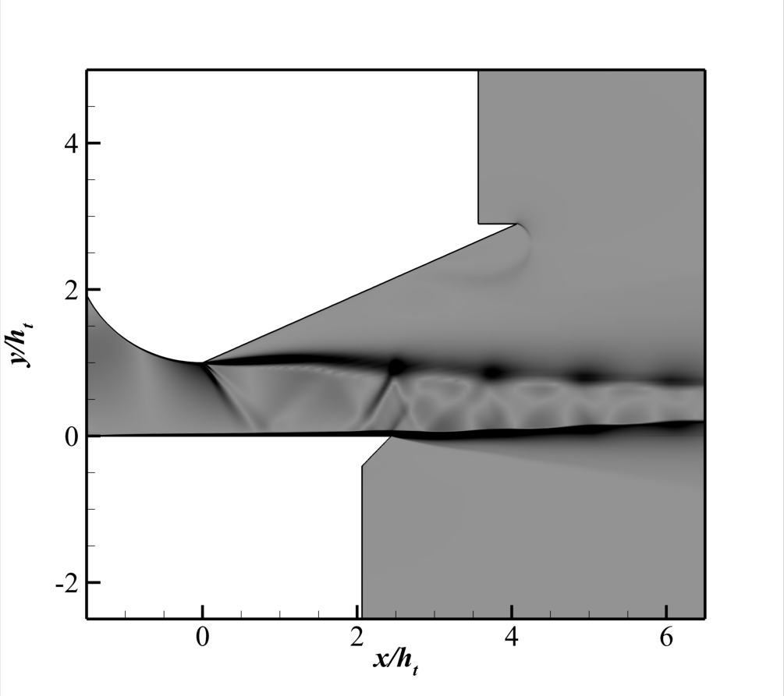
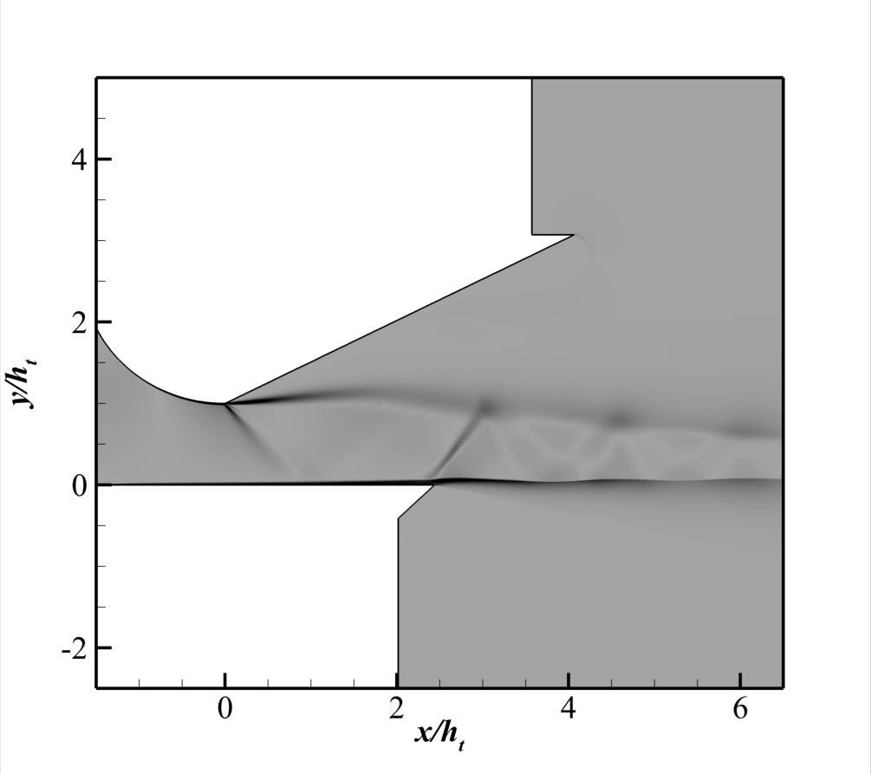
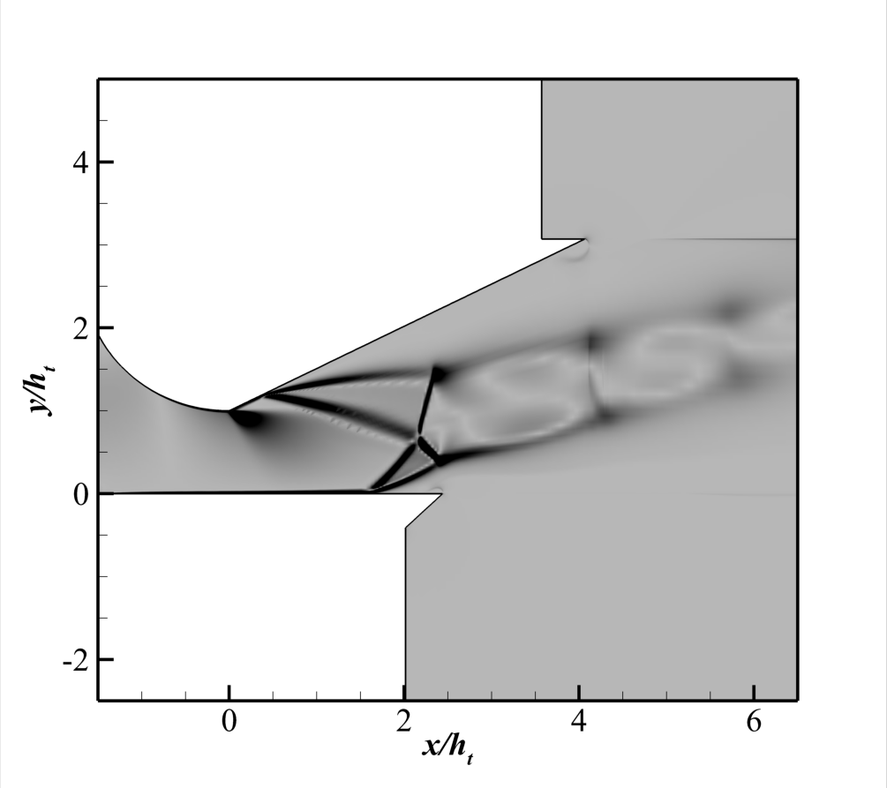
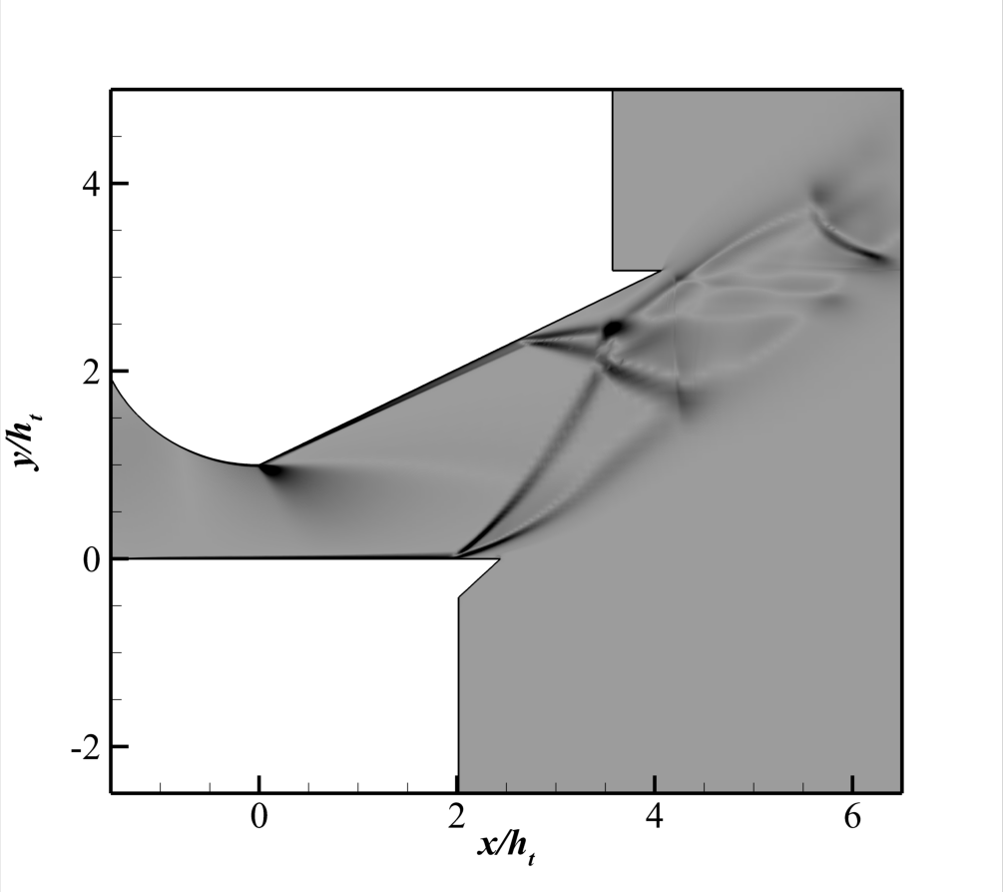
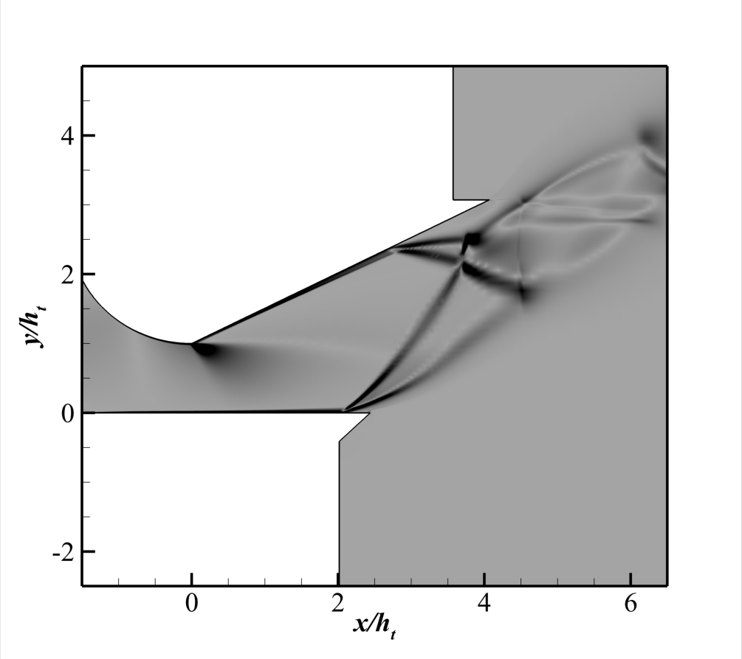

Results: Shock Interaction Analysis
(a) NPR 2.4
(b) NPR 2.7
(c) NPR 3.0
(d) NPR 3.9
(e) NPR 4.2
(f) NPR 4.8
Fig.05: Density gradient Contour for Expansion ramp angle 27 degree at different NPR

Slide 23
Results: Shock Interaction Analysis
25 degree
(a)
(b)
(c)
27 degree
(a)
(b)
(c)
Fig.06: Comparison of Mach Contour for two different Expansion ramp angles at NPR (a) 2.4 (b) 3.0 (c) 3.9

Slide 24
Results: Wall Pressure Distribution Along Expansion Ramp
(a)
(b)
Fig.07: Wall pressure distribution along Expansion ramp for Expansion ramp angle (a) 25 degree and (b) 27 degree

Slide 25
Results: Wall Pressure Distribution Along Flap
(a)
(b)
Fig.08: Wall pressure distribution along Flap for Expansion ramp angle (a) 25 degree and (b) 27 degree

Slide 26
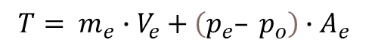
Results: Performance Analysis
Thrust, T
$$T= m_{e}∙V_{e}+\left(p_{e}– p_{o}\right)∙A_{e}$$
m_{e} = mass flow rate at the exit,
V_{e} = exit velocity,
p_{e} = exit pressure,
p_{o} = Free stream pressure/back pressure (p_{b})
A_{e} = exit area
Fig.09: Thrust for Expansion ramp angle (a) 25 degree and (b) 27 degree at different NPR values

Slide 27
Conclusion
FSS and RSS can both occur in SERNs, although RSS is the predominant and widespread separation pattern that can be seen in almost all SERNs. The separation bubble produced in the RSS often appears on the expansion ramp.
As the NPR increases, the point of flow separation moves downstream while the point of reattachment moves by a smaller distance upstream resulting in a shortened separation bubble
The separation flow in SERN shows oblique shock waves as its primary form of shock waves. As soon as the separation pattern transfers, the jet angle changes.
Nozzle performance parameter (Thrust) follows an increasing trend upto certain value of NPR and shows decreasing after that NPR

Slide 28
Future Scope
A single expansion ramp nozzle (SERN) can be utilized to investigate the impact of high altitude on flow separation and flow characteristics.
An analysis in three dimensions can be performed. The simulation will be enhanced by incorporating a number of real-life phenomena

Slide 29
References
J. M. Delery, Shock wave/turbulent boundary layer interaction and its control, Progress in Aerospace Sciences, 22, pp. 209–280, (1985).
Bourgoing and P. Reijasse, Experimental analysis of unsteady separated flows in a supersonic planar nozzle, Shock Waves, 14, pp. 251–258, (2005)
Y. Yu, J. Xu, J. Mo, and M. Wang, Principal parameters in flow separation patterns of over-expanded single expansion ramp nozzle, Engineering Applications of Computational Fluid Mechanics, 8, pp. 274–288, (2014).
Y. Yu, Y. Mao, T. Yu, and S. Xu, Numerical Investigation on Mechanism of External Flow Field–Induced
Separation Pattern Transition, Journal of Aerospace Engineering, 36, pp. 1–11, (2023)

Slide 30
Motivation
THANK YOU

